Slide 1


What Catholic Radio IS NOT
Radio Industry Principles for Strategic, Listener-Centric Catholic Evangelization

Slide 2

The Master Principle of Radio
"People don't listen primarily because of who you are; they listen because of who THEY are!"
— John Frost

Slide 3

Catholic Radio IS NOT About the Broadcaster's Ego or Personal Preferences
Industry Insight
Ego (self-centered perspective) is the #1 reason stations fail. It shuts out outside wisdom, research, and listener feedback.
Catholic Translation
Broadcasters must serve the listener's spiritual and emotional needs, not their own favorite devotions, esoteric theological interests, or personal pulpits.

Slide 4
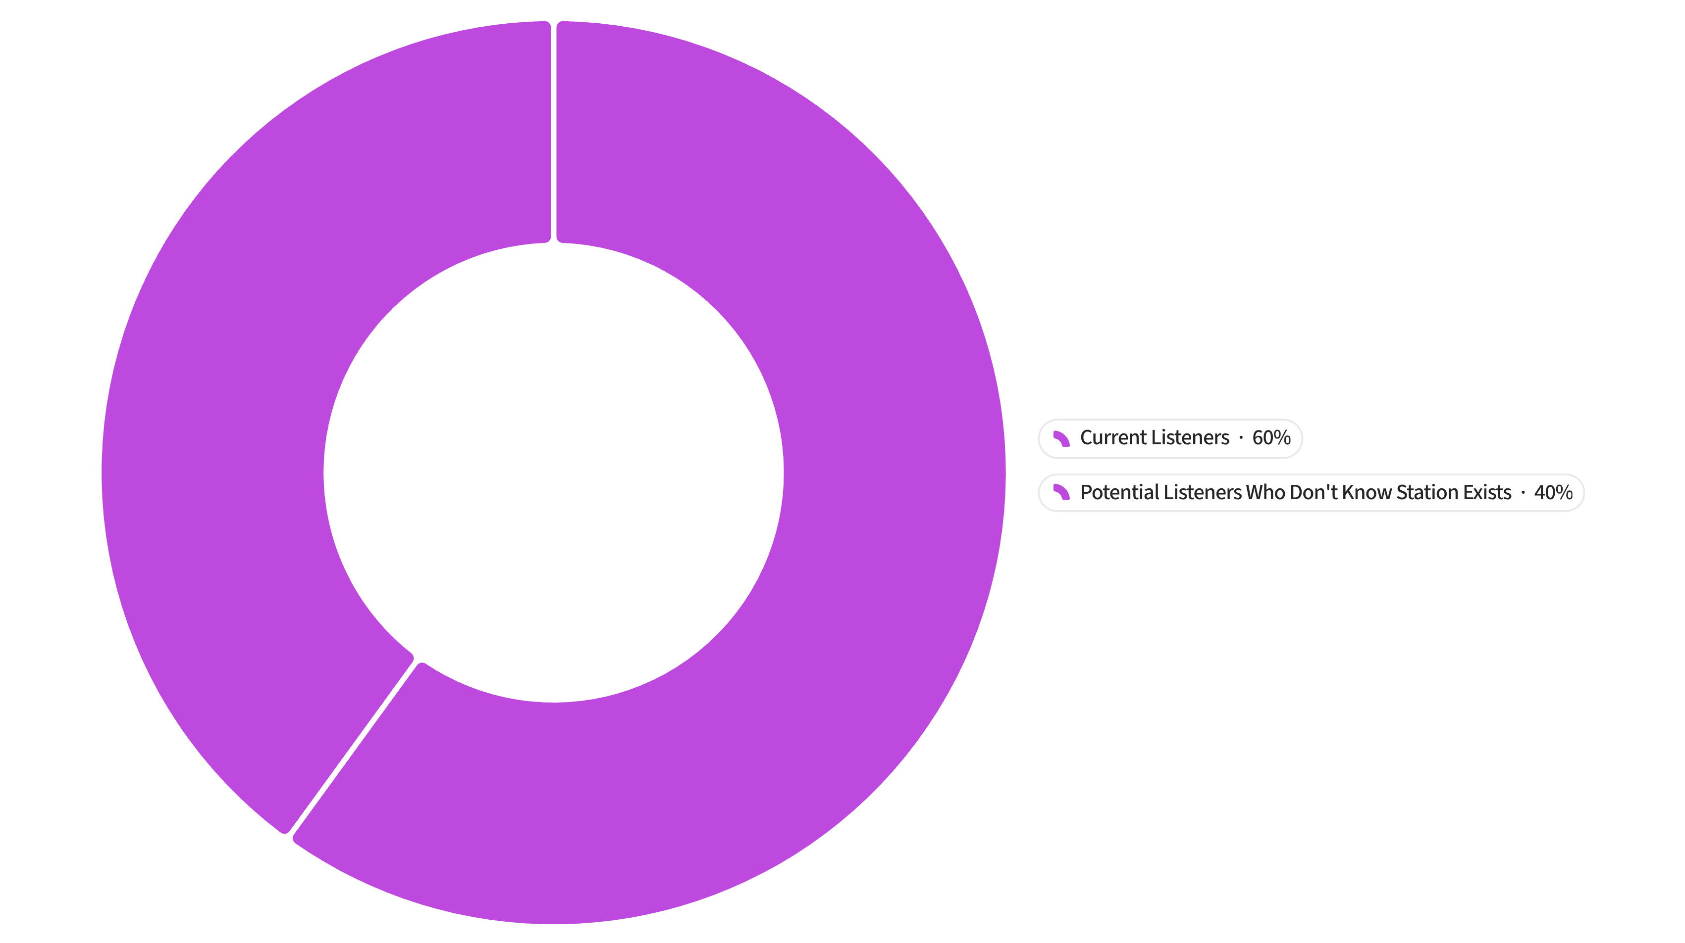
Catholic Radio IS NOT a "Secret Society" for the Already Converted
Industry Insight
Catholic Translation
Research shows 40% of potential listeners
who would love the content simply don't know the station exists.
Its primary mission is outward-facing—
reaching the struggling Catholic, the lukewarm seeker,
and the commuter looking for truth.

Slide 5

Catholic Radio IS NOT "1 Year of Experience Repeated 30 Times"
Industry Insight
Catholic Translation
Relying on old habits and fearing change creates deadening status quo radio.
Sacred truth is timeless, but broadcasting methods must evolve. Embrace professional coaching, airchecking, and modern radio standards.

Slide 6

Catholic Radio IS NOT Afraid of "Bad News" or Honest Feedback
Industry Insight
High-performing media leaders cultivate a culture of candor: "Bring me the bad news!"
Catholic Translation
Teams must distinguish between criticizing the Catholic Faith and evaluating radio presentation. Humility demands confronting low numbers directly.

Slide 7
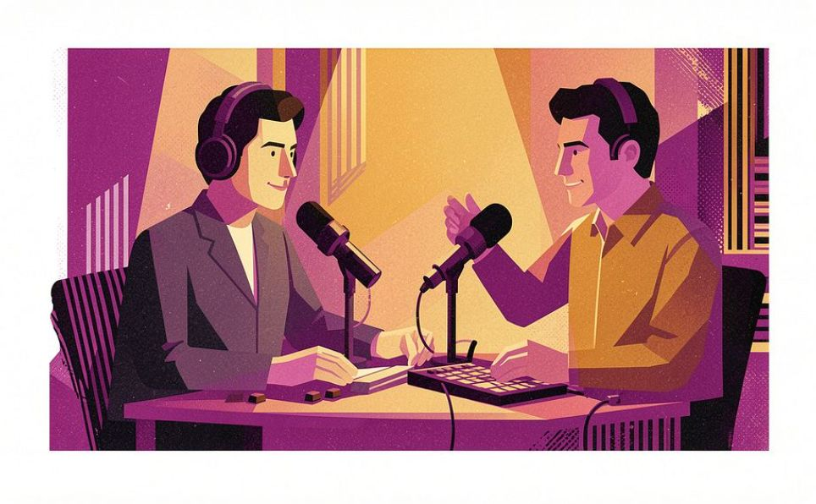

Catholic Radio IS NOT an Uncoached Assembly of "Just Catholic Stuff"
Industry Insight
Catholic Translation
Throwing content on the air without training and ongoing talent coaching leads to high tune-out.
On-air talent need active coaching, encouragement, and skill development to translate deep theology into accessible, captivating broadcasting.

Slide 8
A structured, professional development series designed to equip Catholic radio leadership — GMs, PDs, and on-air talent — with the tools to build listener-centric, mission-driven stations.
WHAT NOW? | Q&A
EAR@EWTN.COM

