Slide 1




Exercising Healthy Imaging
EWTN RADIO WEBINAR
z

Slide 2
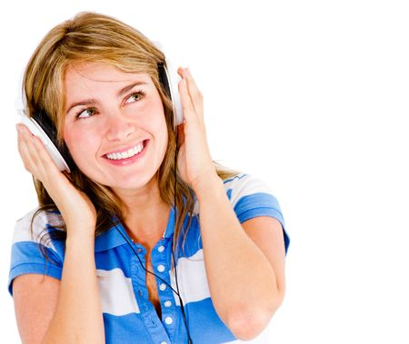
Main Objective
Engaging our audience with words. To paint the canvas every day in story (live or written) to evoke emotions that keep bringing them back to our stations.

Slide 3

Where do you Start?
Find the Emotion not the information
Make the time and write regularly
Collaboration
Make Pinterest Your Friend

Slide 4
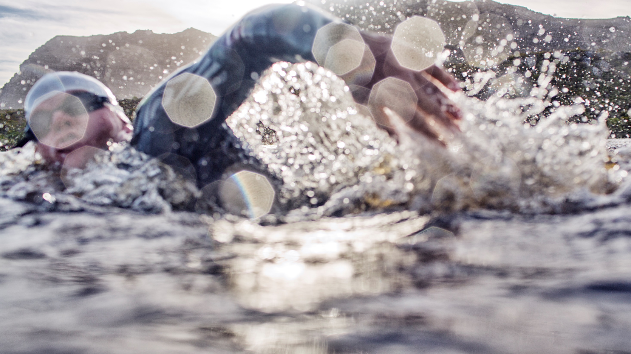
Tools
BIBLE
SPACE
calendar

Slide 5
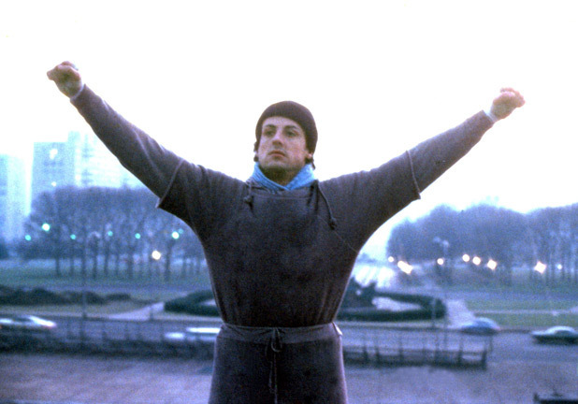
Exercise Plan
z
Inviting
+
compassion
x
transparency
=Winning Promo

Slide 6
Fitness
Progress
Healthy
Examples
Super
Bowl
Commercials
A.I.
Movie Trailers
Affiliate
Mentoring
Goals
Lexus
Ads
z
If your imaging is right, then your pledge drives will be right and you’ll hear the difference.

Slide 7

Thank You
z
amckay@ewtn.com

