Slide 1
Engaging Young Catholic Audiences
WEBINAR

Slide 2

Why?
Why do 18-24 year olds choose the Catholic Faith?
Cultural ties
Family Tradition
Spiritual Beliefs
Sense of Community, rich history & traditions

Slide 3


Why young adults don’t identify with ANY faith?
Reasons for this can range from skepticism towards organized religion, disillusionment with religious institutions, or a focus on personal spirituality outside of traditional religious frameworks.

Slide 4


So what do we do to draw them in:
5 Ways to Engage:
Play to our strengths –Use the teaching and repurpose them for social media and podcast.
They have to know we care-Show the heart of the Catholic Body/Church
Meet them Where they are-Social Media & Podcasting
Get them involved-Street Team & Internships-In our relationships in the community, promote openings and the needs you have.
TALK TO THEM!-A focus group with pizza or tacos can you far.

Slide 5
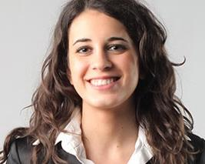
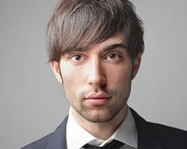
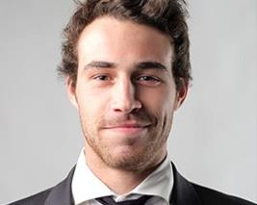
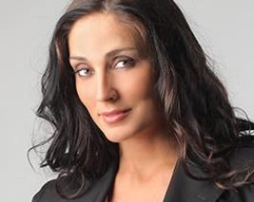
C H E C K L I S T
Youth-Centric Topics:
Guest Interviews:
Faith and modern culture, relationships, mental health, social justice, and technology.
Invite young Catholic leaders, artists, musicians, and influencers
Interactive Segments:
Music Selection:
Call in, share their thoughts on social media, or participate in polls and quizzes
Playlist of contemporary Christian music and Catholic hymns that appeal to younger audience
Ask Steve re: music licensing

Slide 6

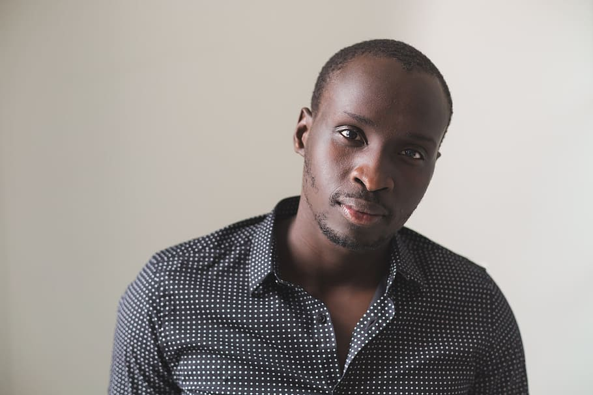

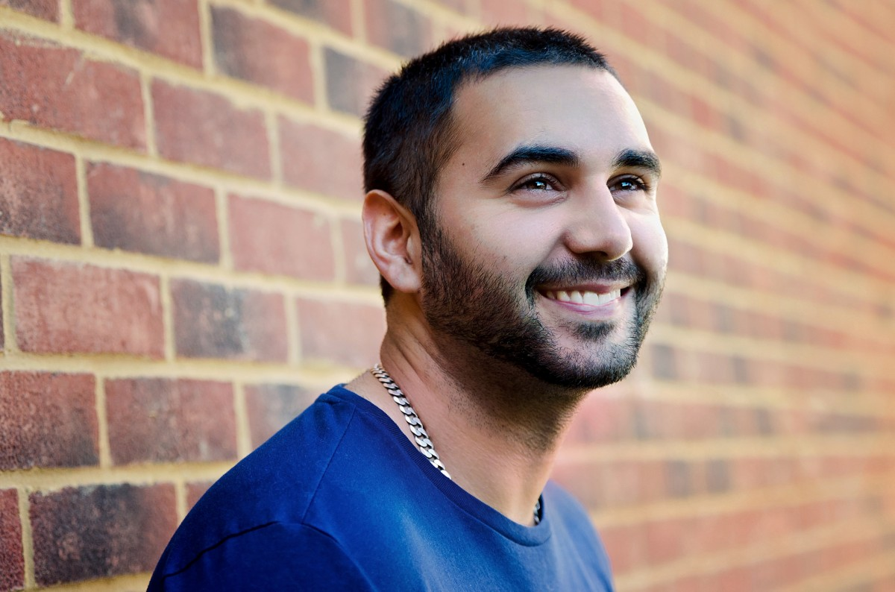
C H E C K L I S T
Youth Testimonials:
Youth Group Spotlights:
Feature personal stories and testimonies from young Catholics
Highlight activities, events, and initiatives from local youth groups and Catholic organizations
Digital Platforms Integration:
Question & Answer Sessions:
Utilize social media platforms
Dedicate segments to answering questions from younger audience

Slide 7




Also consider:
Youth-Focused Events
Community Outreach
By incorporating these strategies, you can create a dynamic and engaging radio program that resonates with younger Catholics and fosters a sense of community and belonging.
Faith Formation
Storytelling

Slide 8

28
Remember: It’s Not Your Parents Catholic Radio. They want something that’s exclusively for them.

Slide 9






Photo Collage

