Slide 1

Your Social Media
Optimizing
Unlock the secrets to increasing engagement and expanding your reach on social media platforms.
EWTN Radio Affiliates

Slide 2

Social Media has become the on ramp to people finding our station(s) and finding their faith.
There are two questions to ask before diving in or in reevaluating your social media.

Slide 3

What are the Platforms?
Primary:
Facebook
Instagram
Twitter
Secondary:
Tik Tok
Snapchat

Slide 4

What are you trying to accomplish?
1. Engage with someone
2. Encouragement
Social media is a place to reach people who have never heard of you, heard the word of God or even think fondly of the Church and the people.

Slide 5

Grow our platforms
3 Steps to
Transparent, Creative & Mission minded

Slide 6


Learn how to craft compelling content that resonates with your target audience.
Posting Daily is the Long Term Goal

Slide 7

The average video post is a minute and should not exceed that.
Each post should have a call to action as well.
Be sure to caption them!
Mixing it up!

Slide 8

“The message of hope is king.”
Value to Connect

Slide 9
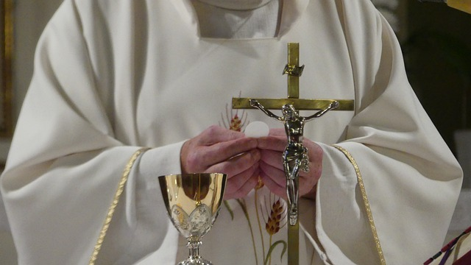
Lastly, Church is about community.
Show them compassion, grace and make them want to come back!
Host/Station Connection

Slide 10
Discover the best practices for leveraging different social media channels to grow your brand
Lean Heavily on Value-Based Messaging
The Value of When & Sharing
Once a day on Facebook & Instagram and unlimited on Tik Tok & Twitter.
1pm is Best!
A positive experience
And mostly: People want to feel a part of something.

Slide 11

Be That
Something

Slide 12

Uses the tools to your advantage
Consider boosting your post

Slide 13

It’s A Marathon
Not a sprint.

Slide 14
What NOW!?
The goal is pick 1 platform & post daily
Step 1: Weekly Post to FB & Instagram
Step 2: 3 Times a Week
Step 3: Once you get to the daily post, branch out to at least one additional platform

Slide 15


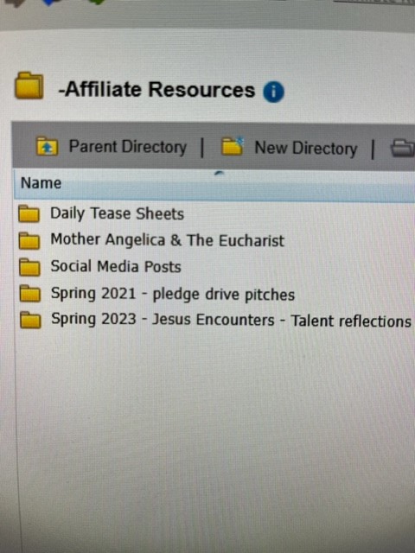
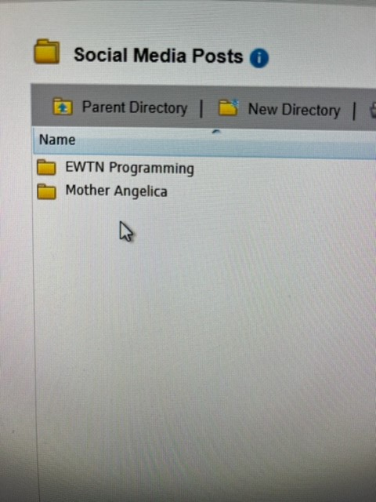


Slide 16







Q & A
Time

