Slide 1
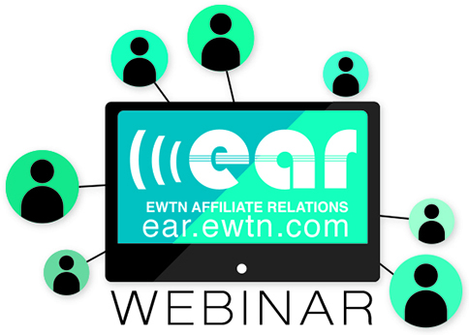

Slide 2
Third Millennium Media
Hosted over 300 Catholic Radio Pledge Drives
Helped stations and networks raise over $150 million
Already host up to 30 pledge drives annually
Some clients are booked through 2021
Contact jerry@yourcatholicmedia.com or 619.888.8858

Slide 3
A Successful Pledge Drive is the Fruit of Your 24/7/365/366/4 Efforts
Good Programming
EWTN
Local
Quality Breaks
Copywriting
Voicing
Production
Community Involvement
Parish Talks
Events (Attending and Sponsoring)
Donor Engagement
Regular E-Mail
Outbound Calling
Prayer Intentions

Slide 4
When Should You Air Your Pledge Drives?
Winter
Spring
Summer
Fall
Advent
Lent
Easter

Slide 5
Promoting Your Pledge Drive
How Long Before Your Drive
Mailing
On-Air Announcements
E-Mail Blasts
Parish Representatives
Social Media

Slide 6
The “Stages” of Your Drive
Pre-Drive
On-Air
Post-Drive

Slide 7
What Format Should You Use?
Regular Programming
In-Studio Guests/Interviews
Combination

Slide 8
Professional Presentation
On-Air Talent Must:
  Have Excellent Radio Skills
  Be Able To Juggle Many Things at Once
  Know the Faith Though and Through
  Be Able to Conduct Intelligent Interviews
  Be Sincere, Persuasive and Convincing When Inviting People to Call and Pledge

Slide 9
Matching Money
How to Acquire It
Offering It On the Air
Frequency of Using Matching Money

Slide 10
Other Important Things
Donor Premiums
Volunteers
Food
Following Up

Slide 11
Third Millennium Media
Hosted over 300 Catholic Radio Pledge Drives
Helped stations and networks raise over $150 million
Already host up to 30 pledge drives annually
Some clients are booked through 2021
Contact jerry@yourcatholicmedia.com or 619.888.8858

Slide 12
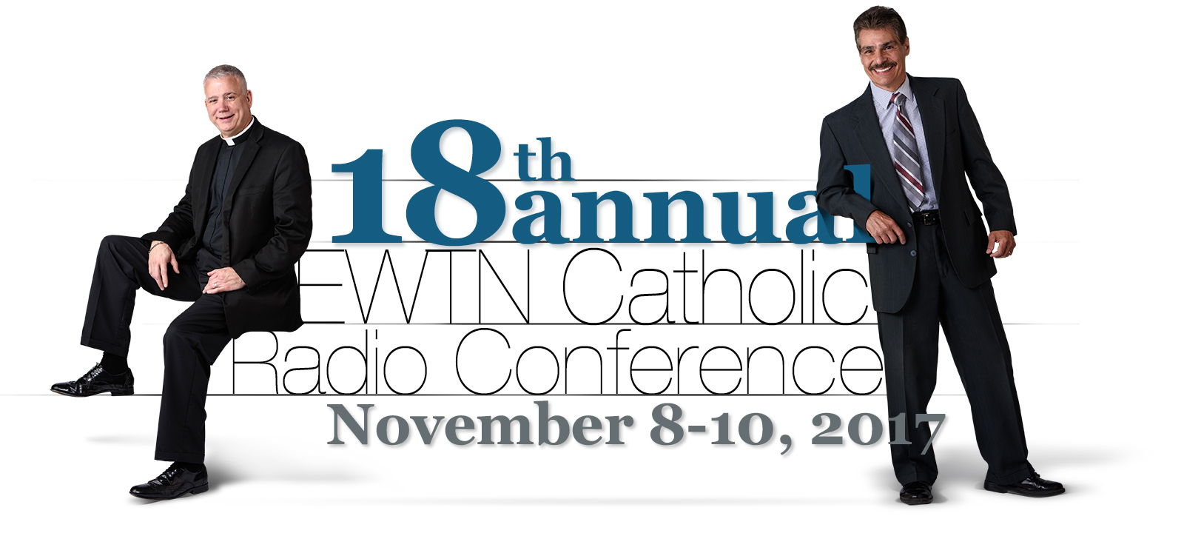
www.ewtnrc.com

