Slide 1



Ready, Set, Show:
Good to Great Prep
With Ace McKay, Matt Swaim, Anna Mitchell & Teresa Tomeo
Elevate Your Show, Engage Your Audience
by Ace McKay

Slide 2
Ready, Set, Show:
Good to Great Prep
With Ace McKay, Matt Swaim, Anna Mitchell & Teresa Tomeo
Elevate Your Show, Engage Your Audience
by Ace McKay

Slide 3


Be Ready
The Power of Prep
Build Listener Loyalty
From Good to Great: Use what's working, change what's not, have a rotation
With transparency and truth
What Makes You Unique?
OVER PREP
Identify your show's distinctive qualities
Boost confidence, reduce stress

Slide 4
Understanding Your Audience
Beyond Demographics
How to Listen to Them
What are their daily routines?
Social Media Engagement
What are their biggest interests and concerns?
Call-ins & Texts
What makes them laugh or think?
Surveys & Polls
Put Them in the Story |
“Why Should They Care?”

Slide 5




Fueling Your Show
Content Sources
Google, News sites, Catholic Register, Hashtags, Flipboard
A.I. Tools
Chat GPT, Gemini, Radio Content Pro (with subscription)
Crafting Questions
Open-ended (Who, What, When, Where, Why, How), Listener-focused. Avoid Yes/No questions!

Slide 6

Content & Segments
Building Your Show Structure
Effective Benchmarks
Effective Guests
Transparent approach
Create segments that become appointment listening for your audience while maintaining authenticity throughout your content.

Slide 7
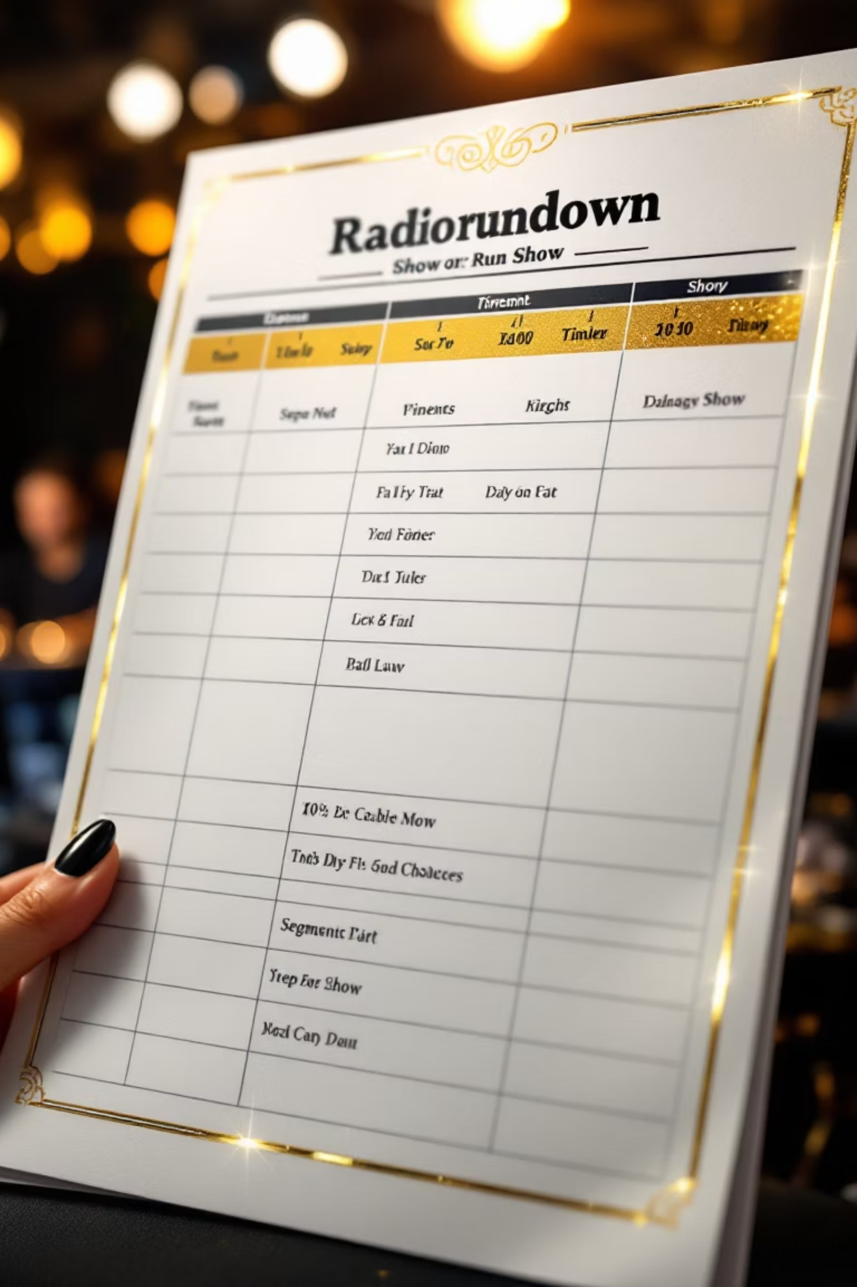



Structuring Your Show
The Show Clock
Content & Emotion need to rotate. Create natural energy arcs.
Effective Teases
Make appointments with listeners. What's coming that they can't miss?
Seamless Transitions
Smoothly move from one element to the next with natural flow.

Slide 8

Tools for Efficient Prep
Work Smarter, Not Harder
Any of these and all of these will help streamline your preparation process, allowing you to focus on creating compelling content rather than getting lost in the details.

Slide 9

Your Role Off Air Shapes Your On-Air Performance
"Your role off the air is your lens
that helps you see how it goes on the air!"

Slide 10
Ready, Set, Show:
Good to Great Prep
With Ace McKay, Matt Swaim, Anna Mitchell & Teresa Tomeo
Elevate Your Show, Engage Your Audience
by Ace McKay

