Slide 1
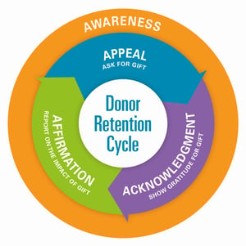
EWTN Radio Affiliate Webinar

Slide 2
Is Donor Retention based upon donors who gives to you annually?
What might your Pledge fulfillment, Percentage of pledges made and fulfilled indicate? How do you increase response?
What is your plan breakdown
Donors Giving under $250
Donors Giving over $250, but less than $1,000
Donors Giving over $1,000

Slide 3
Keys to Success:
Board member involvement
Communicate Mission
Transparency
Deepen Relationship
Pilgrimage, Volunteerism
Other communications

